Slide 1
OPEN COURSE PHYSICAL ACTIVITY HEALTH AND WELLNESS
Department Of Physical education

Slide 2
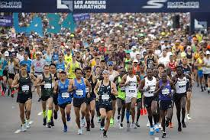
Physical Education
DEFINITION
AIMS & OBJECTIVES
IMPORTANCE OF PHYSICAL EDUCATION
PHYSICAL FITNESS
TYPES OF PHYSICAL FITNESS
COMPONENTS OF PHYSICAL FITNESS

Slide 3
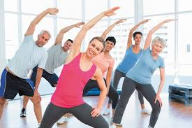
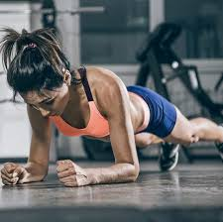
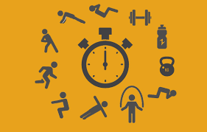
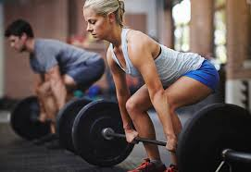
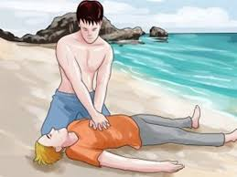
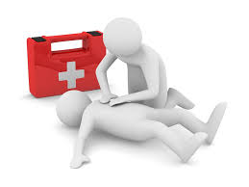
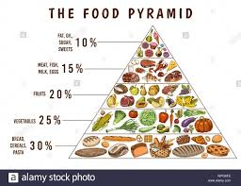
Exercise
Types &principles Exercises
First Aid
Aims & principles
Nutritional Balance

Slide 4
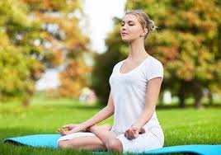
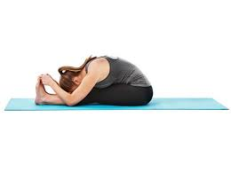
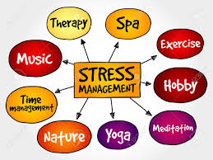
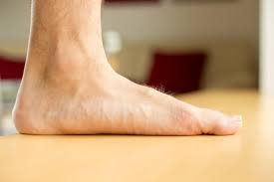
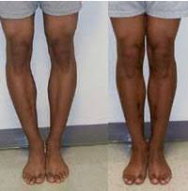
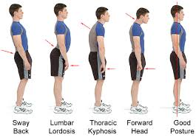
YOGA
STRESS MANAGEMENT
POSTURAL DEFORMITIES

Slide 5
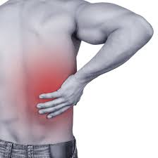
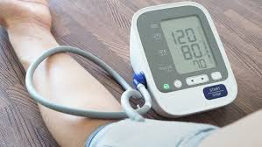
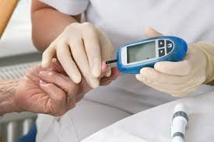
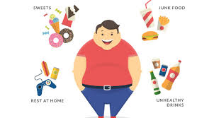
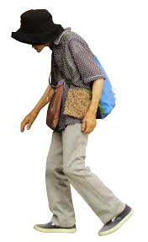
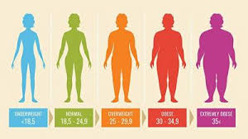
LIFESTYLE DISEASES &MANAGEMENT
HEART RATE
BLOOD PRESSURE
DIABETES
OBESITY
HYPERTENSION
OSTEOPOROSIS
BACK PAIN

