Slide 1
OPEN COURSE OF DEPT. OF MATHEMATICS
SUBJECT CODE : MTS5D04
SUBJECT NAME: MATHEMATICS FOR DECISION MAKING

Slide 2
MAIN TOPIC OF DISCUSSION
Statistical tools for Data Analysis and Data Interpretation
MODULE 1:
Variables and Graphs
Frequency Distributions
Measures of Central tendency
Measures of Variation

Slide 3
MODULE 2:
Basic Concepts of Probability and Counting
Conditional Probability and the Multiplication Rule
The Addition Rule
MODULE 3:
Probability Distributions
Binomial Distributions
More Discrete Probability Distributions
Normal Probability Distribution

Slide 4
RELEVANCE OF THE PAPER
BPO companies use these statistical
tools for Data analysis.
Learning this paper is advantageous to
the students who seek jobs in BPO companies.

Slide 5
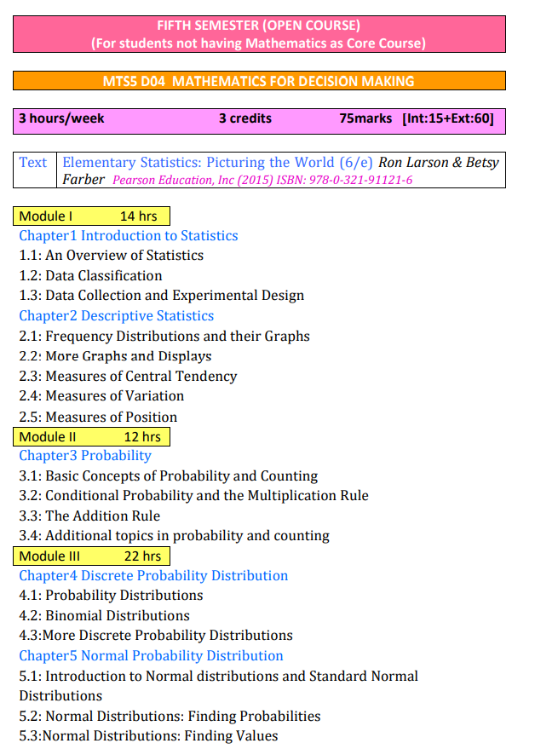
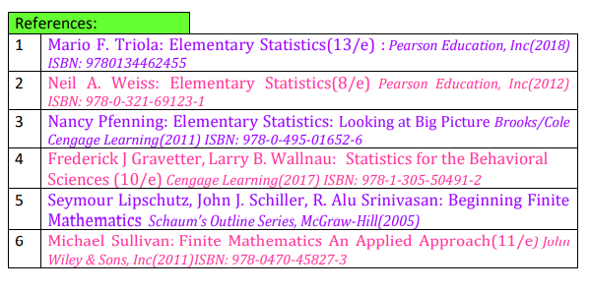
SYLLABUS

